Slide 1

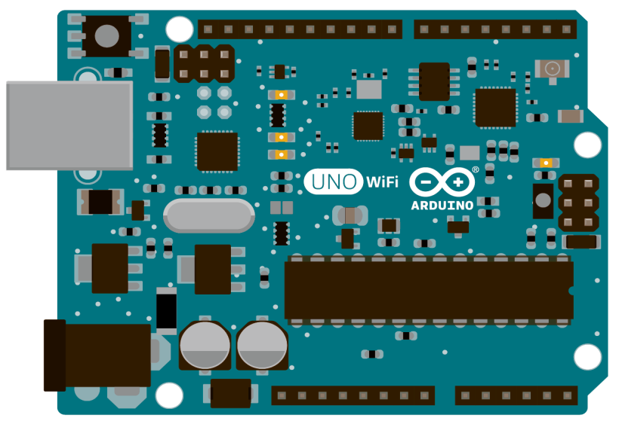
ACHARAYA INSTITUTE OF TECHNOLOGY
LED CUBE
USING
ARDUINO BOARDS
PRESENTED BY:-
Sheethal Heremagalur Sridhar

Slide 2
INDEX
Introduction to Microcontroller
Introduction to Arduino
ATmega328 microcontroller chip
Realtime application of Arduino
Implementation using Arduino (4x4x4 led cube)
Conclusion

Slide 3
MICROCONTROLLER
Used in automatically controlled products.
These are manufactured by the companies like :–
Atmel
Texas Instruments
Silicon Laboratories
Intel
Fujitsu

Slide 4
WHAT IS ARDUINO?
Arduino is an open-source prototyping platform based on easy-to-use hardware and software.
Based on ATmega328 – 8BIT
Takes input from sensors, buttons and output to LEDs, motor, etc.
It is programmable using Arduino Software(IDE).
Supports multi platforms (Win/Mac OS/Linux).
USB Programmable
Inexpensive
Large Community

Slide 5
WHY ARDUINO?
It is an open-source.
It is flexible.
Easy connectivity.
It is inexpensive.

Slide 6
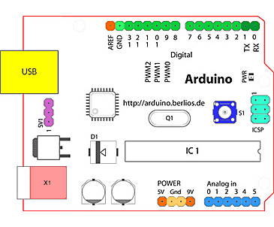
ARDUINO BOARD OVERVIEW

Slide 7
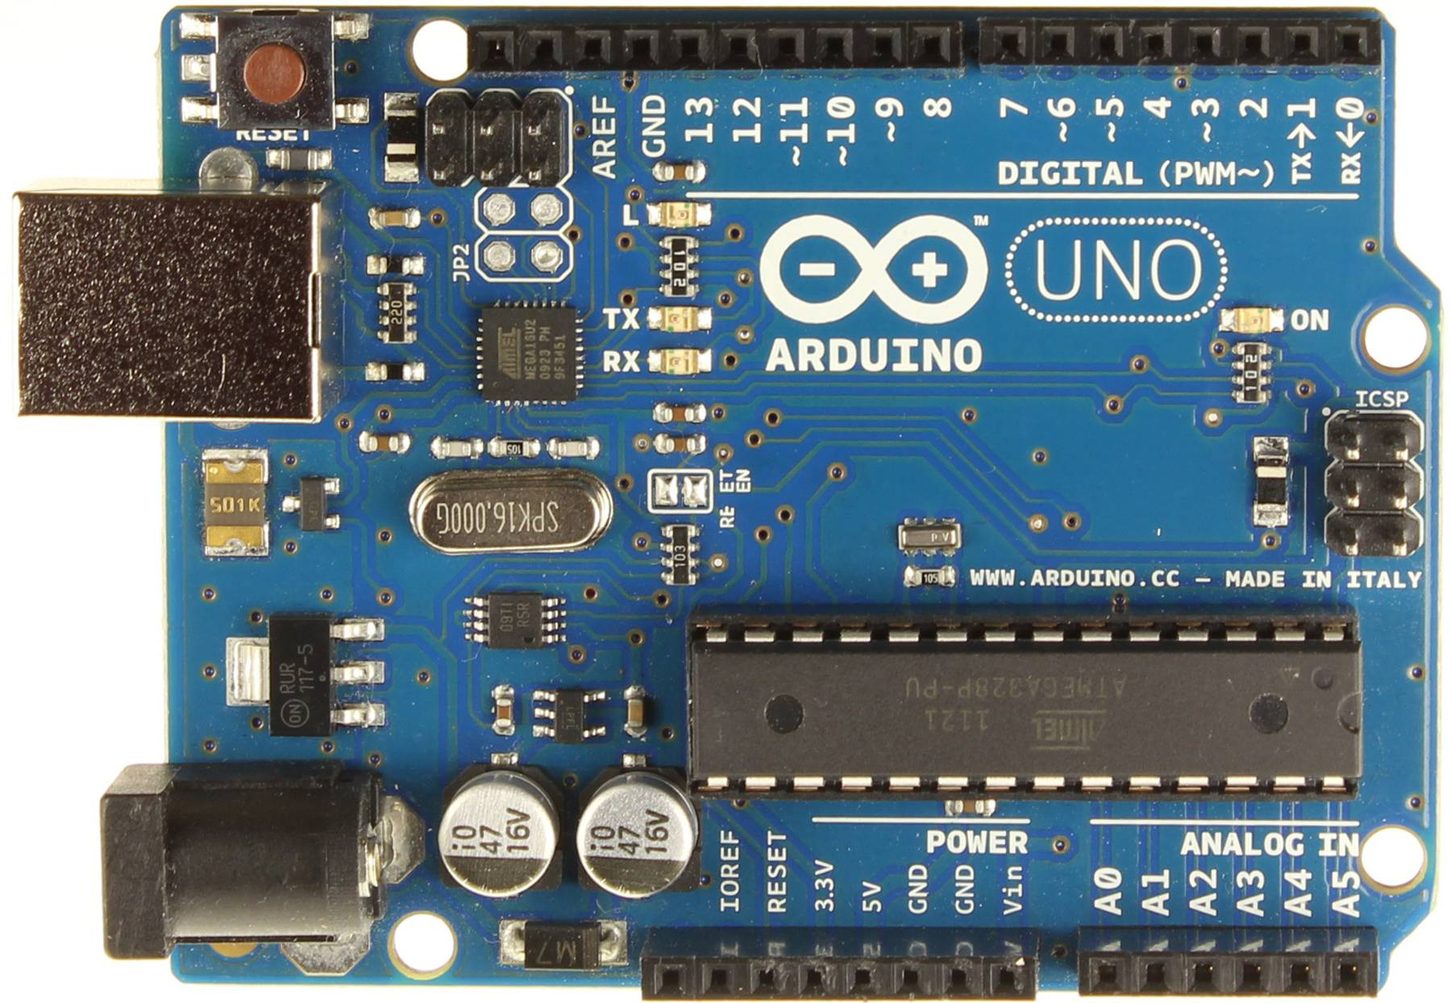

Slide 8
COMPONENTS ON BOARD
USB port for programming.
Voltage Regulator.
DC power input.
Analog input pins.
Digital input & output pins.
ATmega328-8bit.
Crystal oscillator.
PWMs
Reset button.

Slide 9
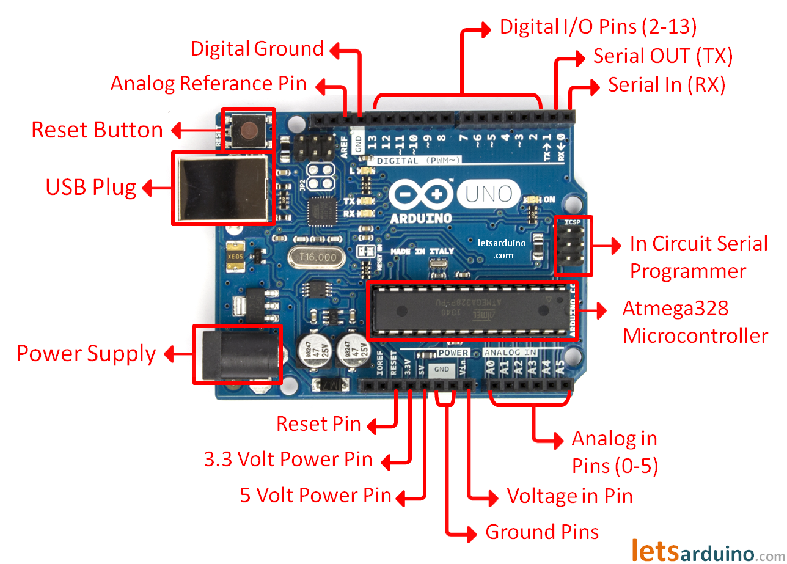

Slide 10
SPECIFICATIONS
Microcontroller ATmega328
Operating Voltage 5V
Input Voltage (recommended) 7-12V
Input Voltage (limits) 6-20V
Digital I/O Pins 14 (of which 6 provide PWM output)
Analog Input Pins 6
DC Current per I/O Pin 40 Ma
DC Current for 3.3V Pin 50 Ma
Flash Memory 32 KB (ATmega328) of which 0.5 KB used by bootloader
SRAM 2 KB (ATmega328)
EEPROM 1 KB (ATmega328)
Clock Speed 16 MHz

Slide 11
ARDUINO CHIP ATMEGA328P MICROCONTROLLER

Slide 12
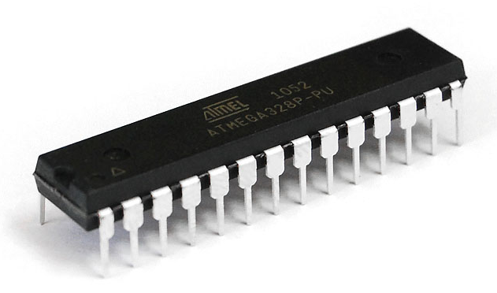
ABOUT ATmega328p microcontroller
The ATmega328p is a single chip micro-controller created by Atmel and belongs to the megaAVR series.
The Atmel 8-bit AVR RISC-based microcontroller.

Slide 13
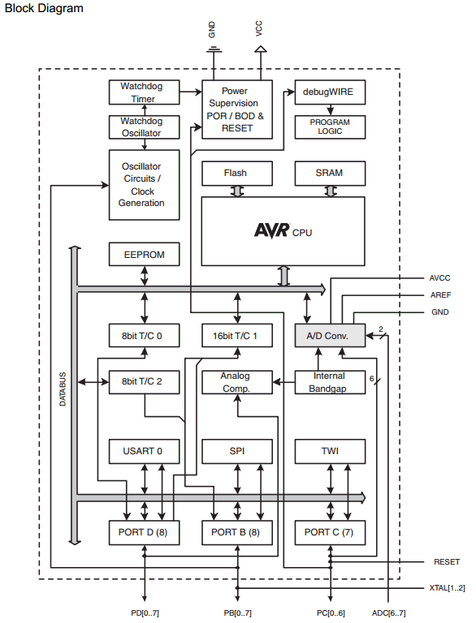
Block Diagram

Slide 14
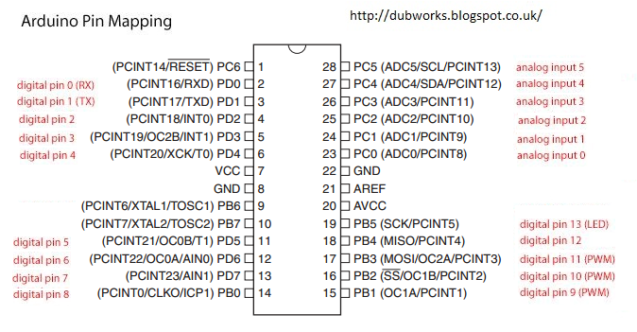
ATmega328p Pin Detail

Slide 15
REALTIME APPLICATION OF ARDUINO

Slide 16
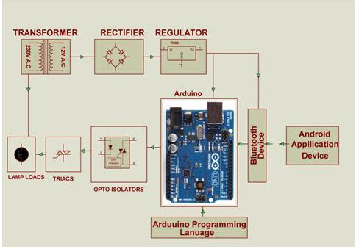
Arduino Based Home Automation System
The project is designed by using Arduino uno board for the development of home automation system with Bluetooth which is remotely controlled and operated by an Android OS smart phone.

Slide 17
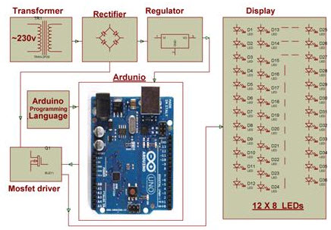
Arduino based Auto Intensity Control of Street Lights
This system uses arduino board to produce PWM pulses and it is programmed in such a way that it decreases the voltage applied to these lamps gradually till late nights and completely shutdowns at morning.

Slide 18
4X4X4 LED CUBE IMPLIMENTATION USING ARDUINO BOARD

Slide 19
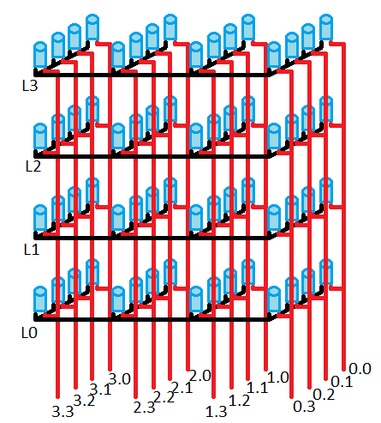
LAYER 3
LAYER 2
LAYER 1
LAYER 0
X-Y MATRIX

Slide 20
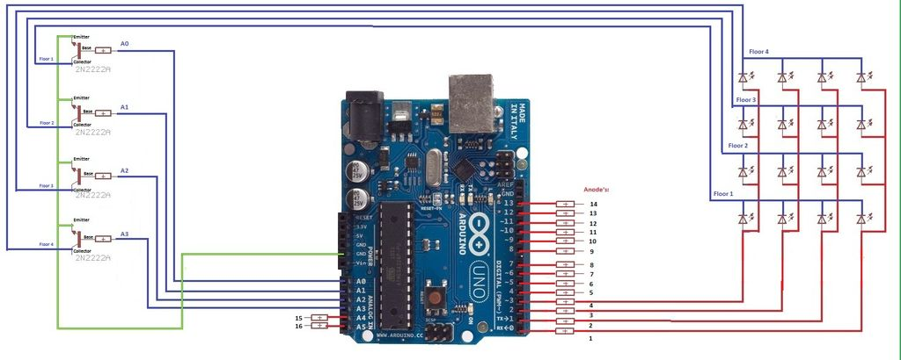
CONNECTIONS
Power input
FOR LAYERS
FOR XY MATRIX
ARDUINO BOARD

Slide 21
COMPONENTS REQUIRED
Arduino Board (Uno)
64 LEDs
Connecting wires
Power source(power bank , wall adapter , etc.)
Soldering Iron (to join the connection)
Resisters

Slide 22
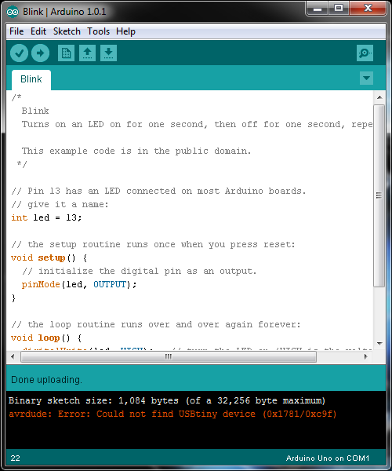
PROGRAMMING
The Uno can be programmed with the Arduino Software (IDE).
The ATmega328 on the Uno comes preprogrammed with a bootloader that allows you to upload new code to it without the use of an external hardware programmer.

Slide 23
Using the implemented 4x4x4led cube some realtime applications

Slide 24
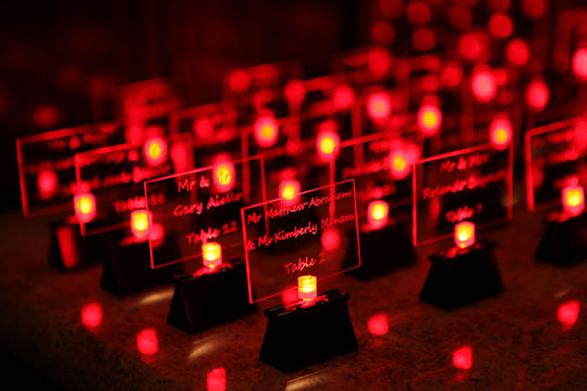
LED WEDDING CARDS

Slide 25
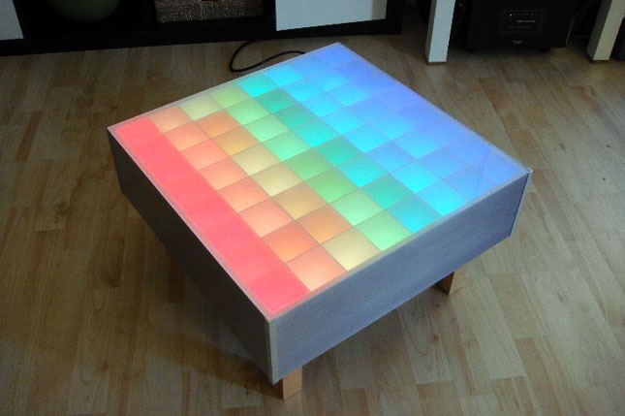
LED COLOUR TABLE

Slide 26
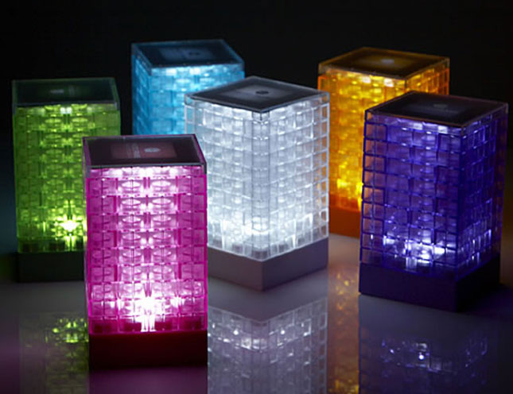
LED MATRIX USED IN LEGO LAMPS

Slide 27

CONCLUSION

Slide 28


Slide 29


